Slide 1
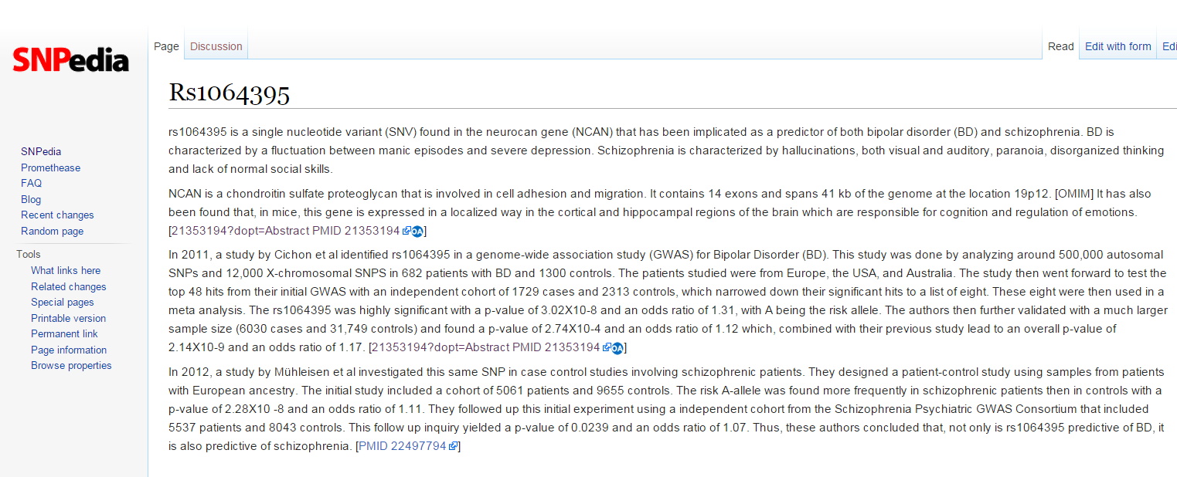

Slide 2
What should be in your SNPedia write-up?
Summarize the trait
Summarize the study
  How large was the cohort?
  How strong was the p-value?
  What was the OR, likelihood ratio or increased risk?
Which population?
What is known about the SNP?
  Associated genes?
  Protein coding?
  Allele frequency?
Does knowledge of the SNP affect diagnosis or treatment?

Slide 3
Summarize the trait
“BD is characterized by a fluctuation between manic episodes and severe depression. Schizophrenia is characterized by hallucinations, both visual and auditory, paranoia, disorganized thinking and lack of normal social skills.”

Slide 4
Summarize the study
How large was the cohort?
How strong was the p-value?
What was the OR, likelihood ratio or increased risk?
“This study was done by analyzing around 500,000 autosomal SNPs and 12,000 X-chromosomal SNPS in 682 patients with BD and 1300 controls.” “The rs1064395 was highly significant with a p-value of 3.02X10-8 and an odds ratio of 1.31, with A being the risk allele. ”

Slide 5
Summarize the study
How large was the cohort?
How strong was the p-value?
What was the OR, likelihood ratio or increased risk?
“rs1064395 is a single nucleotide variant (SNV) found in the neurocan gene (NCAN) that has been implicated as a predictor of both bipolar disorder (BD) and schizophrenia. ”

